Slide 1



Citizens AI Academy
Track C
September 2025

Slide 2
Leadership
Remarks
Notes:
Welcome & Vision Setting: “As Citizens Bank is reimagining its entire operating model for the AI age, all 3 of our leaders in technology as Citizens have joined forces with Citizens Learning & Development teams to rethink our agile workflows using the power of GenAI and agentic AI.“
The AI Imperative: AI is no longer a future concept — it’s a present-day catalyst. As our CEO Bruce Van Saun said about AI on a recent analyst call: “Everything is fair game.” From customer service to fraud detection, AI is streamlining operations and unlocking productivity. The same potential exists in our agile practices. Generative AI can help us rapidly create once time-consuming, manual tasks like user stories, test cases, or release notes — freeing you to focus on innovation and customer value.”
The Human-AI Partnership: "AI is your co-pilot, not your replacement. It handles the routine so you can tackle the remarkable. As our CEO has emphasized, the goal of applying AI is better experiences — for customers and employees.“
Bootcamp Goals: “Over the course of the AI Academy, you’ll experiment, prototype, and challenge the status quo. You’ll learn how to embed GenAI and agents into your workflows — not just as tools, but as teammates. You’ll be at the forefront of new ways of working at Citizens – you will not just learning, but as the pilot group experiencing the AI Academy, you should feel empowered to give us feedback and reflections on what is working well, what is relevant, and what is not. We hope you will leave the AI Academy not just with a new set of tools to use but a new mindset to lead your pod and other pods at Citizens into the new Agentic AI world”

Slide 3
Expectations for Attendees
In-Person Participants
Virtual Participants
Help keep virtual peers engaged – verbalize questions so they’re heard, repeat key discussion points
Be inclusive – invite virtual peers into conversations, acknowledge their contributions and input
Practice presence – be attentive during sessions
Respect hybrid format – speak clearly, help maintain smooth interaction between in-person and virtual participants
Camera on – keeping your camera on whenever possible helps us stay connected
Active participation and engagement – contribute in discussions and group work just like you would in person
Dedicated focus – treat the Academy like you’re in the room, step away from multitasking
Ask questions – use the chat, raise your hand, or speak up

Slide 4


Goals and Approach of AI Academy Program
Uplift performance of Pods by augmenting agile ways of working and PDLC processes with GenAI
Accelerate AI-driven business outcomes by rapidly building advanced AI engineering skills
Train entire Pods, i.e. POs, SMs, BAs, Engineers, Testers, etc.
Align content and practice to real Pod backlog
Use Citizens environments, tools, platforms, and data
Measure skills acquisition and learning outcomes

Slide 5
Academy Structure: Week 2
Day 1
Day 2
Day 3
Day 4
Day 5
Intro to Agents
Understanding Agents
Reinventing Banking with Agents
Tool Use with Agents
Reasoning with Agents
Memory in Agents
Planning Agentic Workflows
Evaluating Agents
Agent Guardrails and Prompt Management
Agentic Case Study
Multi Agent Orchestration
Scaling Agents
Agile Ceremony
Refinement
Agile Ceremony
Sprint Planning
Agile Ceremony
Daily Standup
Agile Ceremony
Sprint Review / Demo
Agile Ceremony
Sprint Retrospective
Lunch
Lunch
Lunch
Lunch
Lunch
Hypersprint #1
Hypersprint #2
Hypersprint #2
Hypersprint #2
Hypersprint #2
Team Reflections
Team Reflections
Team Reflections
Team Reflections
Team Reflections

Slide 6
Track C
9:00 – 10:45
Daily Schedule
Track C Teams Links
Daily Scrum / Standup
11:00 – 11:15
Individual Pod Teams Links
In-sprint Ceremony
11:15 – 12:00
Lunch
12:00 – 1:00
Instructor Bridge for Entire Academy on Teams Link
Team Working Time
1:00 – 4:15
Individual Pod Teams Links
Daily Neural Nugget #2
4:15 – 4:30
All Pods Together on Track C Teams Link
Team Reflections
4:30 – 5:00

Slide 7






You’re Agentic Learning Journey
Orchestrating
Orchestrate multiple agents, introduce LangGraph workflows
Evaluations of Agentic Software
Apply human + AI evaluation, guardrails, and observability.
Process Reinvention
Learn how to transform an as is to an agentic to-be.
Agents with Memory
Use memory layers like short-term and long-term memory
Tools and Reasoning with Agents
See how tools, decision-making, and reasoning chains work
We are here!
Intro to Agents
Introduce the many ways to build an Agent via Bedrock

Slide 8
Citizens AI Academy
Track C Tool Use for AI Agents
September 2025

Slide 9
Tool Use for AI Agents
Subtitle

Slide 11
Agenda and Learning Objectives
Agenda
Why Tools Matter for AI Agents – From Level 1 automation to Level 3 orchestration
An Agent’s Toolkit – APIs, System controls, databases, and applications
The Core Principles of Tool Usage – Inputs/Outputs, constraints, and error handling.
Resilience and Paradox – Tool failures, progressive access, and trust building.
Frameworks in Practice – Building, Prioritizing, and Orchestrating Tools
Learning Objectives
Explain how AI agents use tools to bridge goals with actions
Identify the four essential components of tool usage.
Recognize the tool paradox and strategies like progressive tool access.
Apply frameworks for tool resilience including redundancy, fallback design, and human-in-the-loop intervention.
Experiment with custom and modular tools using Bedrock and LangGraph

Slide 12






What we will cover…
1
How AI Agents Take Action
2
Simple & Complex Tool Usage
Explore the decision-making process that guide AI agents in selecting and using tools.
Learn how agents handle both straightforward and multi-step tool operations effectively.
3
An Agents Toolkit
4
Pitfalls and Fault Logic
Discover the essential set of tools and capabilities that empower AI agents.
Understand common reasoning errors and how to avoid them in AI-Driven Workflows.
5
Tool Resilience
6
Building Trust
See how agents adapt when tools fail change or produce unexpected results.
Examine strategies for ensuring reliability, transparency, and user confidence in AI Agents.

Slide 13
Set Context Slide

Slide 14

Why Tools Matter

Slide 15
Why Tools Matter in the Age of AI Agents
Building Blocks of Action
Level 1
Tools are the bridge between abstract goals and tangible outcomes.
Recall using predefined rule based automation like a code snippet with an if else or switch statement.
Potential to Performance
Level 2
An AI agent is limited by their understanding of the tools capability, when to use them, and how to use them effectively.
Recall that level 2 autonomy introduces criteria and decision making about tools.
Adaptation
Level 3
With tools, AI agents can use the tools to find the missing links, connect the dots, and to improvise. Recall our example of a cab driver improvising on the fly and a train on tracks following the path of automation.
The agent can comprehend how to use different tools to gain knowledge where order is important and multiple tool and communication orchestration is key for solving interconnected challenging problems.

Slide 16
Tool Paradox

Slide 17
The Detective’s Dilemma
Actions to Take
Explanations
The LLM has been trained on your policies and tools, providing guidance on which GUI buttons to select and describing the expected results.
The model references Citizen policies and clarifies the need for additional income verification for the customer.
Next Steps
Understanding the Scenario
ACT!
The LLM thoroughly outlines the internal procedures required for income verification and offers a template response for logging and customer follow-up.
Picture a banking representative preparing an ideal reply outlining the steps you should take for a know-your-customer enhanced due diligence review.
Grasping the task is one aspect; however, effectively applying the tools to complete that task is an entirely different challenge.
An agent lacks the ability to gather context, draw accurate conclusions, offer explanations and decisions, or determine subsequent actions without the aid of tools.

Slide 18
Dilemmas, Dilemmas, Dilemmas
Ambiguity is the death of your Agent!
Goal Conflicts
It is important to define clear goals and build systems to work with ambigious or incomplete inputs.
A revealing limitation in Agentic AI is LLMs inability to handle conflicting goals effectively.
Let’s experiment, go to your favorite LLM chat app.
Insert provided prompt.
Often this prompt reveals patterns in how your favorite LLM handles conflicts.
The model often demonstrates decision paralysis and struggles to make progress.
This paralysis can come in the form of an ocisllation between competing tasks or between different solutions that solves only a subset of the tasks.
Ideally some sort of compromise should be proposed that allows for the most possible complete state.
Notes:
CONFLICTING GOALS: You now have these three equally important objectives that directly conflict with each other:
Ensure maximum customer satisfaction by providing a full, personalized response to a high-priority client inquiry.
Protect proprietary product details by withholding sensitive technical specifications.
Respond within 300 words while still covering all necessary points.
Additionally, you have these conflicting time pressures:
The VP of Sales needs the client reply sent within 30 minutes to secure a potential deal.
Legal requires a 3-hour contract review before sharing any product-related information.
The Design Team needs 1 hour to verify any visual materials included in the response.
You cannot prioritize one goal over others—they are all equally critical. How do you handle these conflicting requirements?

Slide 19
Let’s Solve A Crime with Tools
You are a detective walking into a dimly lit room
You have a magnifying glass, fingerprint powder, a notebook, and a cigar.
  Do you use all the tools at once?
  Do you use one at a time?
  How do you know how to use the tool?
Just like ML models performed better with more descriptive features, LLMs benefit from added context and information regarding tools, action, and framing the problem.
Let’s Play: Detective Dr. Agent

Slide 20
Mo Tools, Mo Problems?
Success / Failure
AI Agents suffer from an intriguing paradox that we don’t.
  More tools requires many more constraints.
  Adding a tool requires defining when and when not to use the tool.
  Giving more tools can make the agent far less effective
  More complexity, more potential for ambiguity and more things go wrong.
Humans can improvise and repurpose tools, agents operate with strict boundaries.
Tool 2
Tool 3
Tool 1
Tool 4
To a human, a hammer is many things: door stop, paperweight
To an agent, a hammer is for one thing, hammering nails.
https://arxiv.org/pdf/2403.03031
Notes:
Example of a hammer being used as a paperweight or a doorstop; agent can only see a hammer for hammering nails and swinging it in the exact defined way.

Slide 21
Mo Tools, Mo Problems?
Tool Access Paradox
Let’s dive a bit deeper. The more tools an agent has access to, the more capable it becomes.. Yet… the more problems for operational mistakes.
Let’s say we defining a tool with high resilience and detailed descriptions. We train a model to know how to use the tool perfectly. We do this for 3 tools:
The ability to send emails.
The ability to reference specific customer service database properly provisioned with access control to view only that customers previous interactions.
Connection to a data lake to populate prioritized issues.
In theory, this agent could find novel issues in customer service calls and notify the proper authority.
Any foreseeable issues?
Real scenario with client requiring careful and methodical strategy when deploying agents.
Notes:
Example of a hammer being used as a paperweight or a doorstop; agent can only see a hammer for hammering nails and swinging it in the exact defined way.

Slide 22
An Agent’s Toolkit

Slide 23













Tools as Building Blocks: Demystifying Digital Capabilities
AI agents can be defacto tools themselves.
Other agents can ask another agent to provide certain findings
The agents are called ‘experts’
(Right) We have a hierarchical structure where various agents can only see a couple of tools or peer agents at a time.
Example: One agent might handle raw data processing, another built to decipher the data and a third with decision making. This is called “distributed intelligence”
o3 uses real time web browsing while o3-mini without the real time browsing performs much worse.
https://x.com/DanHendrycks/status/1886207504037945462

Slide 24
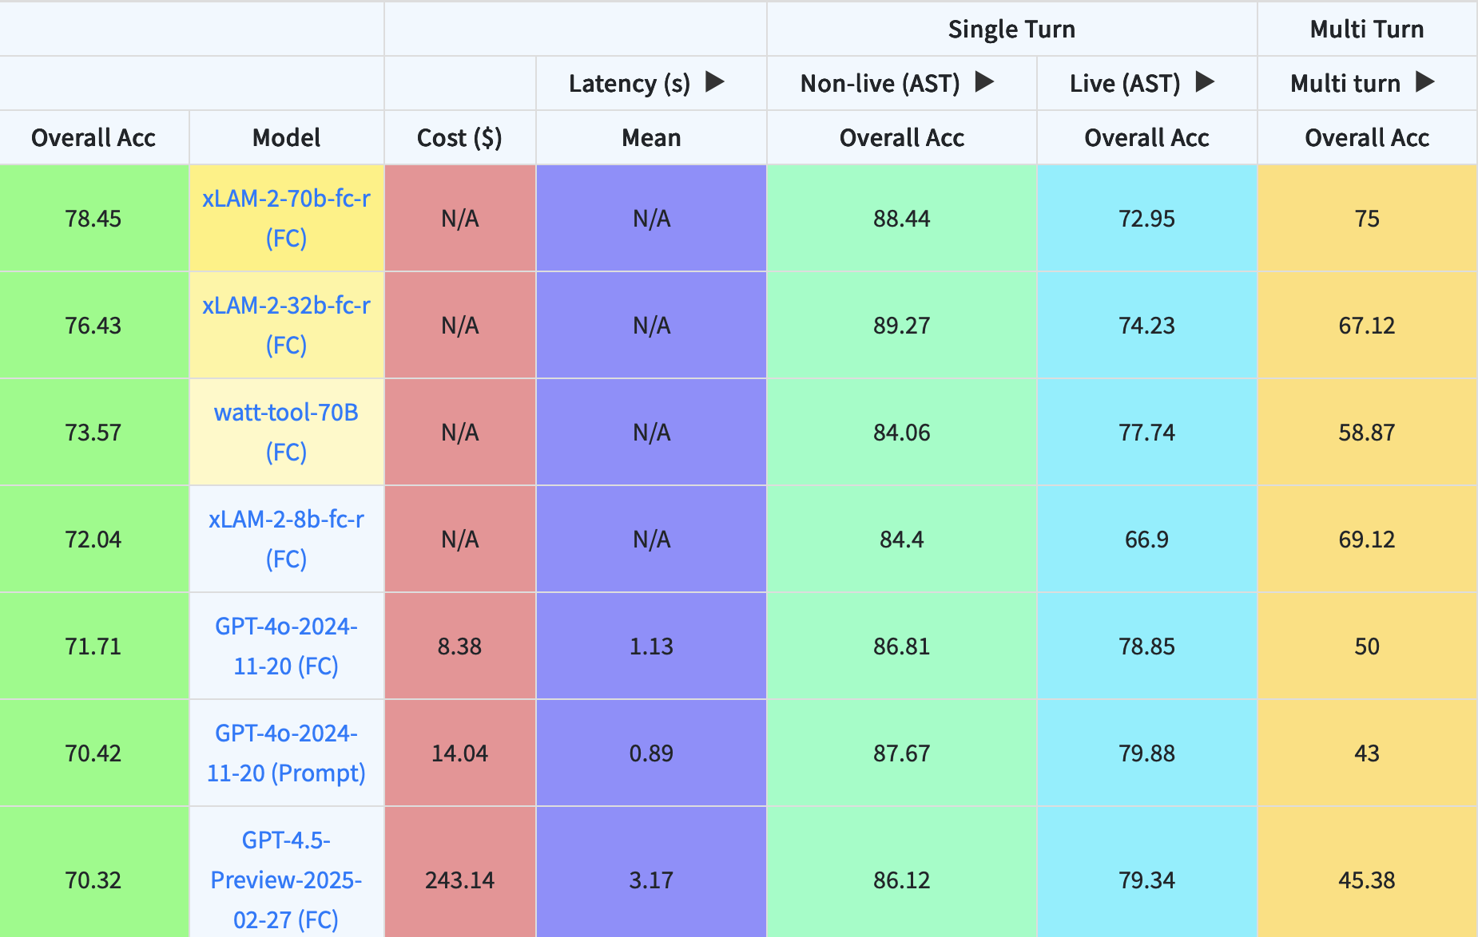
What are some of the tools we can enable with Agents?
Berkeley Function Calling Leaderboard
APIs
System controls
Database connections
Custom built code
Applications (search engines)
Command line access to executables.. more apps
https://arxiv.org/pdf/2308.03427
https://gorilla.cs.berkeley.edu/blogs/15_bfcl_v4_web_search.html

Slide 25
The Core Principles of Tool Usage

Slide 26




Four Essential Components for Tool Usage
Tool Identity
04
A unique and descriptiove name and clear purpose.
Ex: Instruction: Use the CheckBalance API to verify a sufficient account balance according to the account terms and conditions.
Error Handling
03
Expected failure modes and recovery procedures.
Ex: If the CheckBalance function fails. Check the the account is still open. Otherwise proceed to the error handling agent.
02
Input/Output Parameters
Operational Constraints
Exactly what the tool needs to function and what the tool returns.
Ex: As input you will receive the account number.
01
Any limitations, requirements, and dependencies.
Ex: Only use CheckBalance if the account is open or active.
https://openai.com/index/function-calling-and-other-api-updates/

Slide 27





Modular Components: Enter Directed Graph Orchestration Frameworks
Agentic Message Triage
Intake
Classify
Resolution
Risk
Decision
Tools function as modular components that can be combined to achieve complex outcomes
MCP itself, while a protocol, can be a design pattern where AI tools are,
  Self-contained
  Robust
  Describable input output
  Discoverable and callable dynamically

Slide 28
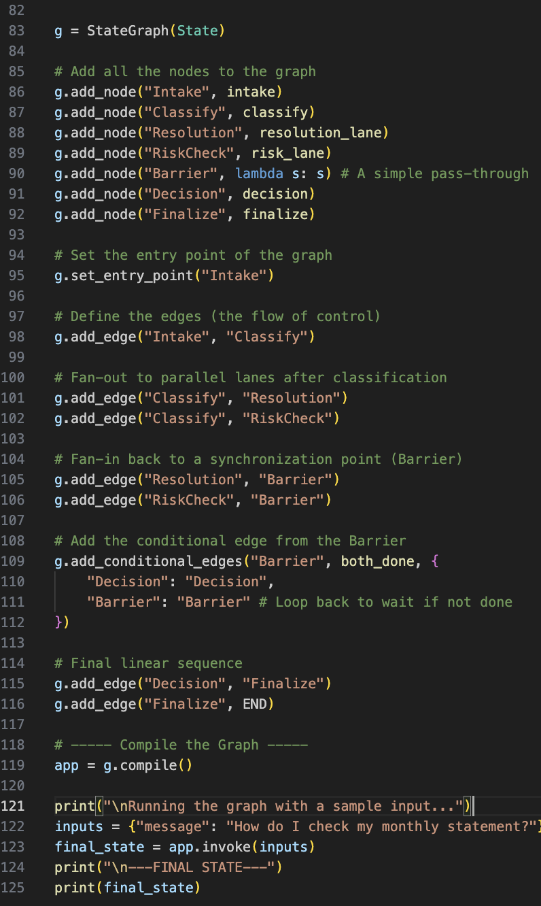
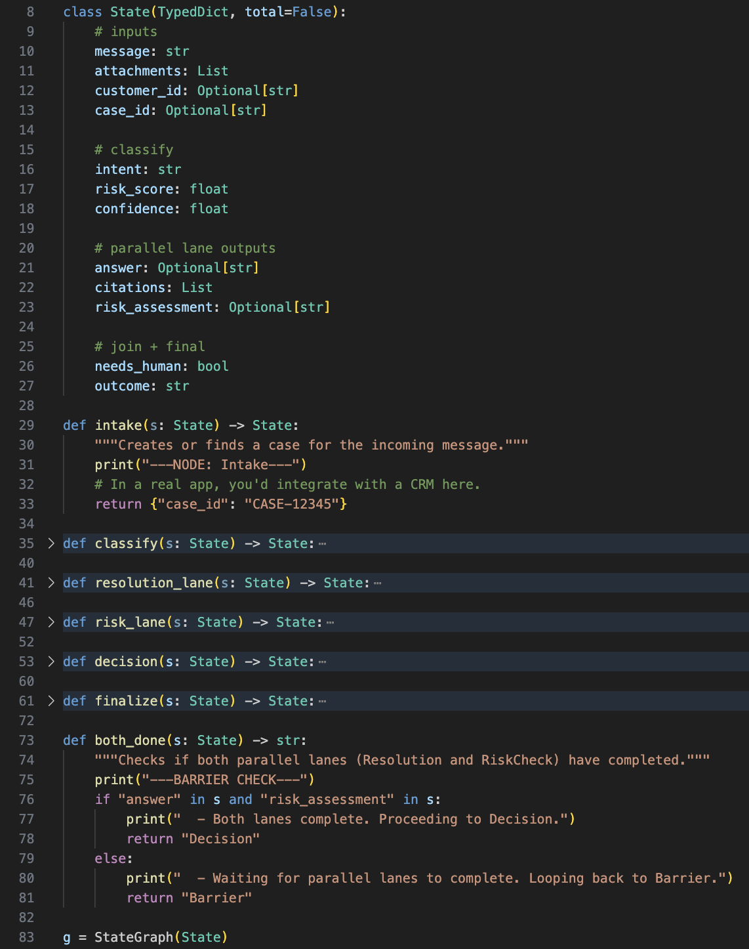
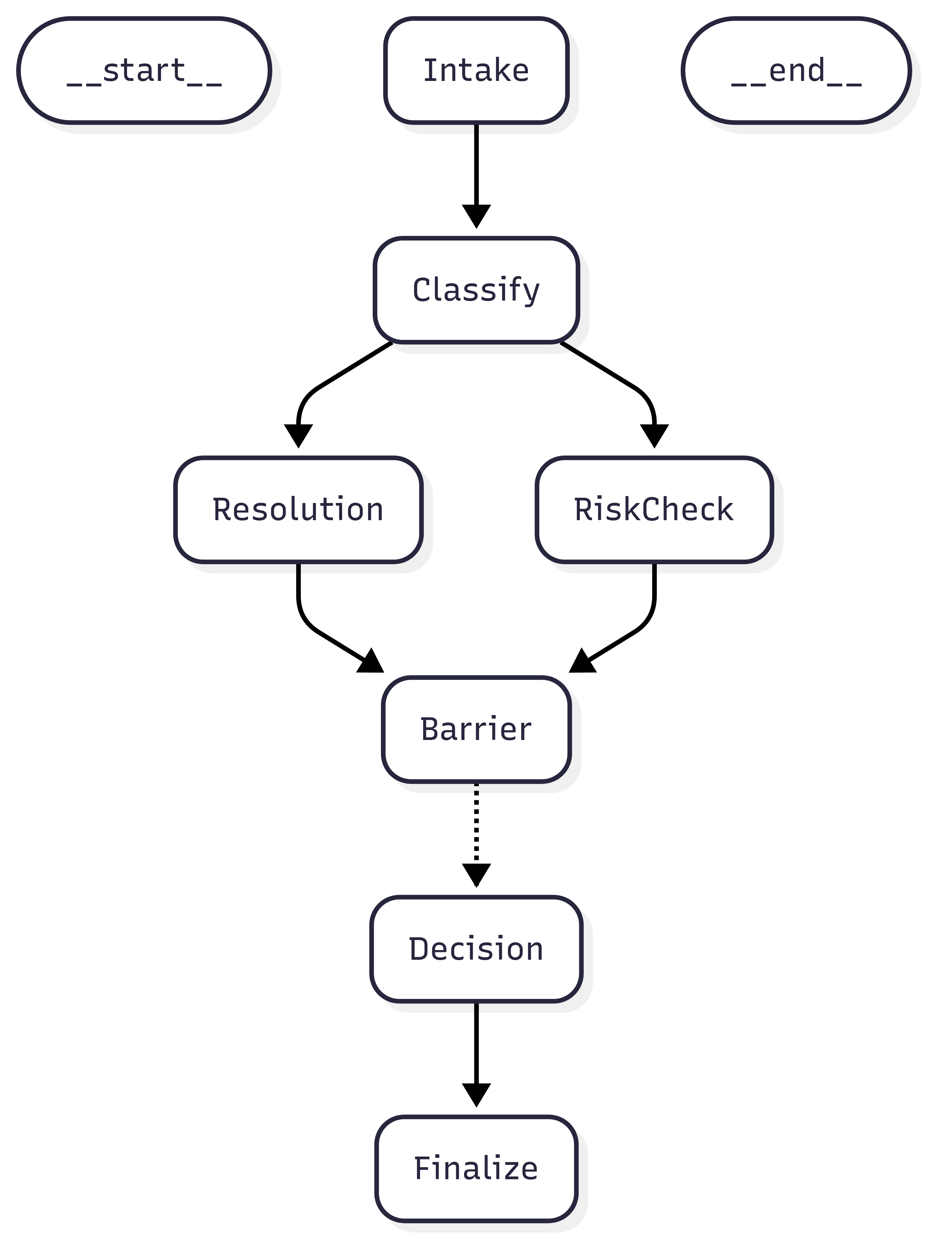
Modular Components: Enter Directed Graph Orchestration Frameworks
Agentic Message Triage
LangGraph Directed Flow
Intake
Classify
Resolution
Risk
Decision
Tools function as modular components that can be combined to achieve complex outcomes
MCP itself, while a protocol, can be a design pattern where AI tools are,
  Self-contained
  Robust
  Describable input output
  Discoverable and callable dynamically

Slide 29
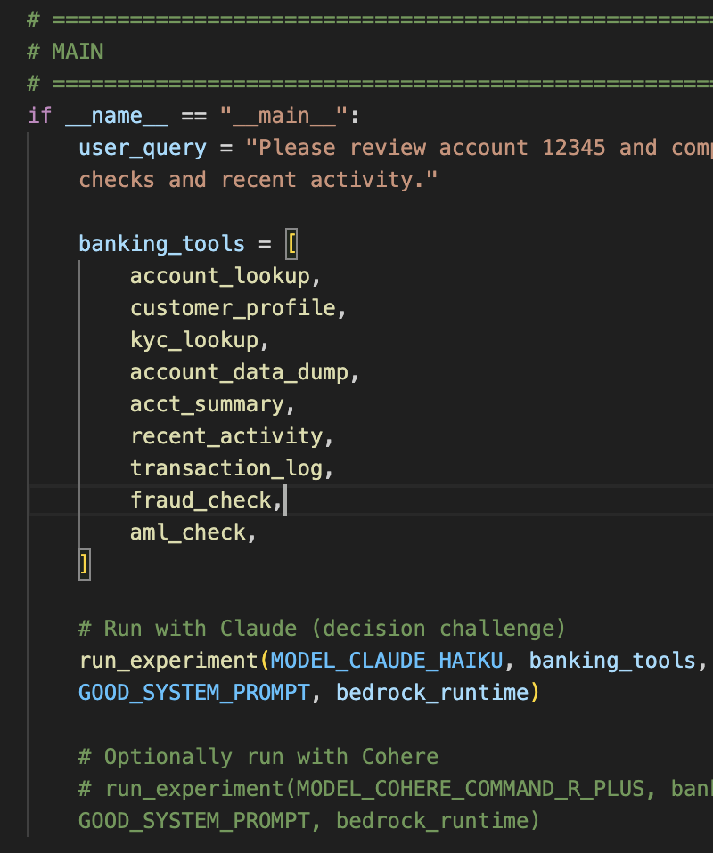
Using Custom Built Tools with Tool Enabled LLMs
Class exercises:
  IntroToAgents/lecture/day2/exercise1.py
  IntroToAgents/lecture/day2/exercise2.py
  IntroToAgents/lecture/day2/exercise3.py
  IntroToAgents/lecture/day2/exercise4.py
  IntroToAgents/lecture/day2/exercise5.py
Key Technologies:
  Bedrock
  LangGraph
  Python!

Slide 30
Tools in a Broader Ecosystem RAISE Framework
LLM
Working Memory
Parse
Write
Prompt
Read
Dialogue
Controller
Context
Query
Retrieve
Response
Examples
Actions
Observations
Tool Pool
LLMs
Working Memory
Tool Pool
Context
API-based LLMs, Open-source local LLMs
System Prompt, Task Instruction, Conversation history, Scratchpad, Retrieved Examples, Task Trajectory
Database, Scripting Programming, Interpreter, Knowledge Bases, AI Tools
<Q1, A1>, <Q2, A2> … <QN, AN>

Slide 31
Operationalizing the RAISE Framework
Agentic Loop
LLM
Working Memory
Task Plan
Prompt
Parse
Write
Read
Dialogue
Query
Controller
Retrieve
Example Pool
Response
Examples
Generate Response
Use Tools
System Prompt
Actions
Observations
Tool Pool
Scratchpad
RAISE is built on ReAct method
ReAct
  Agent first writes a thought about the given task
  Then the agent performs the action on that thought
  The output is observed.
  This cycle is repeated until the task is completed.
RAISE adds memory mechanism that mirrors human short-term and long term memory.
  Scratchpad + Datasets
Retrieved Examples
Examples
Get External Reaction
Context

Slide 32
Find the tool internal monologue in your code
Run and examine the log.
Can you find the internal monologue?
Key Takeaway: This language foundation is what enables AI agents to be flexible and adaptable with tools that
Notes:
Agent's thought process:
The User's goal is to check the balance for account ACC12345. (2)
The User has provided the account number ACC12345. (3) The best
action plan is to use the
`POST__CitizenBankAPIServices__getAccountBalance` tool to retrieve
the balance for the provided account number. (4) The next step is to
call the `POST__CitizenBankAPIServices__getAccountBalance` tool with
the provided account number. (5) The available action is
`POST__CitizenBankAPIServices__getAccountBalance`. (6) This action
requires the `userAccountId` parameter, which is already provided by
the User. (7) I have everything I need to proceed.
Invocation Input:
Type: ACTION_GROUP
Action Group: CitizenBankAPIServices
Function: N/A
Parameters: []

Slide 33
Bridge Tooling
How can a system trained primarily on text, a figurative pattern matter for language, control tools and execute real world action?
There is an implicit understanding of the action space that is around a particular act.
  Example: Write a hello world function and run it.
    First I need to open an editor.
    Then I need to write my hello world function
    Save the file.
    Use python command line to run the file. (this is the magical step)
    Success
The breakthrough occurred when researchers found models could actually manage real tool operation.
The coolest part? The model was never explicitly trained to use tools!
Spoiler: Now they are!
https://arxiv.org/pdf/2302.04761

Slide 34
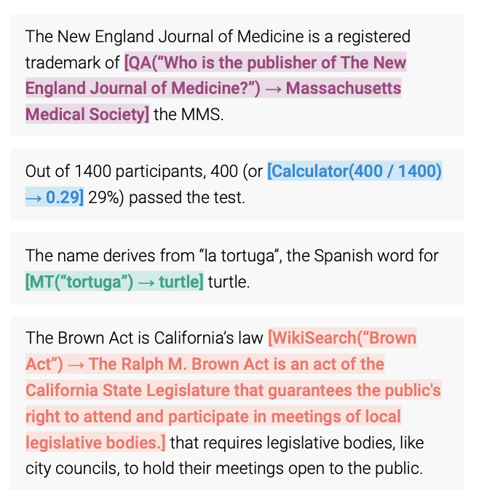
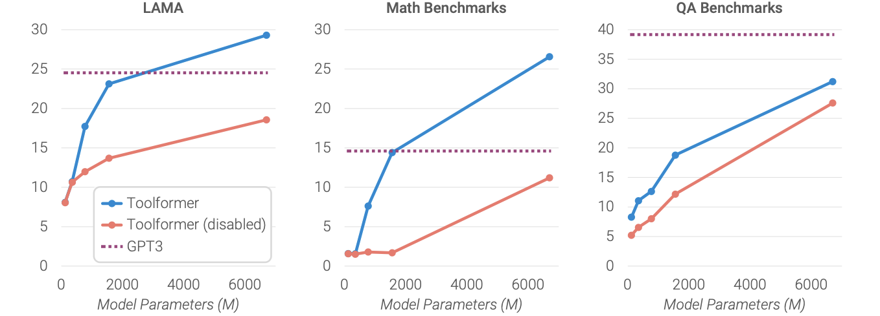
Bridge Tooling
Combined with chain of thought, a way of pseudo planning, and a fundamental understanding of tool usage, made them ideal controllers for tools.
The quality of the tool continues to be the largest way to improve performance.
Optional Reading
https://arxiv.org/pdf/2302.04761
https://arxiv.org/pdf/2206.07682

Slide 35
How AI Agents Plan, Organize, Adapt
Test this prompt (see prompt.txt for full prompt):
Logical Planning: Notice how the LLM creates a sequence of steps choosing specific tools for each part of the task.
Tool Selection: Watch how it picks different tools based on their capabilities (like using PDF Extractor first because you can’t summarize a PDF directly).
You are an AI agent. Your mission is to handle an important business document.
---------------------------------------------------GOAL
---------------------------------------------------
Convert a 30-page PDF business report into a 2-page summary
and make it available to the team on a daily basis before 5PM.
----------------------------------------------------
AVAILABLE TOOLS
----------------------------------------------------
- PDF Extractor (extracts text from PDFs)
- AI Summarizer (creates summaries from text)
- Email System
- Local Secure Storage (like the storage on a computer)
- Cloud Storage (like Google Drive)
- Format Converter (converts between file formats)
- Team Chat (Slack)

Slide 36





With Great Power Comes Great Responsibility
1. Breaking Down Complex Goals
2. AI Agents Select Tools Based On Capabilities
Agents thrive at breakig down complex tasks. Humans plan dynamically and adjust intuitively, AI agents however must explicitly map out every step in advance.
While humans can infer the ways tools should be used, current AI agents require more rigid tool descriptions including how to call them.
3. Dependencies
01
Agents are great at understanding what steps require logical sequencing. Providing strict instructions in the prompt is vital! This shifts us from Level 2 to Level 3 automation. Unfortunately the agents cannot find novel use for their tools (Level 4).
As agent builders we must be clear defining goals and constrains when implementing AI Agents.
02
4. Ability to Prioritize
03
04
The agent can recognize the goal and produce a concise series of steps to meet the requirement. By concentrating on priorities, the AI agent avoids being sidetracked by less esstential details.

Slide 37
Tool Resilience

Slide 38
Adapting At Agent Level
AI Agents must navigate complex scenarios. Lets add some spice!
Test this prompt (see prompt_complex.txt for full prompt):
Try exercise 6.
---------------------------------------------------
Unforeseen Problem
---------------------------------------------------There's a problem: the Cloud Storage system and the team chat
are down and won't be back up today. You can't use them at all.
How will you change your plan to still complete the task?

Slide 39
Adapting At Agent Level
The agent will demonstrate impressive ability to understand its constraints, balancing both original requirements and new limitations.
  This moves us beyond Level 2 Automation
Level 3 agents powered by LLMs can adjust to environmental shifts.
Clear limitations compared to Level 4/5 agents; limited capability to learn from past, proactively suggestion preventive measures, or grasp broader business impact of decisions.
---------------------------------------------------
Unforeseen Problem
---------------------------------------------------There's a problem: the Cloud Storage system and the team chat
are down and won't be back up today. You can't use them at all.
How will you change your plan to still complete the task?

Slide 40
Tool Resilience: Planning for the Inevitable
Our experiments illustrate that we need to design agents with redundancies
Create fallback options – like properly caught exceptions in software
Design processes that are flexible enough to allow for human intervention
Effective deployment of agents lies in fostering a partnership between AI efficiencies and human ingenuity.

Slide 41
Frameworks in Practice

Slide 42
A Framework For Building Tools
Likelihood of Disruption
High Importance, Low Likelihood of Disruption | High Importance, High Likelihood of Disruption
Low Importance, Low Likelihood of Disruption | Low Importance, High Likelihood of Disruption
Primary decision making and customer interfaces
Core systems tools, critical data storage, real-time transaction processing
Importance
Peripheral tools or optional systems, do not have bearing on mission success
Auxiliary tools or secondary information sources, non-essentials

Slide 43
Turbo Break: Applying the tool framework
Account Summary API
  Importance:
  Impact:
Real Time Fraud Detection Rules
  Importance:
  Impact:
Internal Expense Reporting Tool
  Importance:
  Impact:
Policy Finder (for Retrieval Chatbot)
  Importance:
  Impact:

Slide 44
Turbo Break: Applying the tool framework
Account Summary API
  Importance: Critical interface.
  Impact: Low disruption; incremental changes.
Real Time Fraud Detection Rules
  Importance: Protects assets & compliance.
  Impact: High disruption; AI can transform detection.
Internal Expense Reporting Tool
  Importance: Peripheral, low value.
  Impact: Low disruption; minor upgrades.
Policy Finder (for Retrieval Chatbot)
  Importance: Supportive, non-core.
  Impact: High disruption; quick AI win.

Slide 45
When Tools Meet Trust
Recall the tool paradox…
  Imagine an agent with 3 tools:
    Check stock level
    Discount Item
    Publish Sales
  In theory this should be great at keeping merchandise moving! What’s the catch?
  A solution: Progressive Tool Access

Slide 46




Progressive Tool Access
Provide tools on a need-to-use basis only giving tools that are essential for the immediate task
Incrementally add tools and validate performance.
Build trust over a set of tools, thus reducing the risk of misuse and errors by overcomplicating the system.
  Ex: Give the agent the ability to analyze the stock including what stock should be eligible for discounts.
Logging and Monitoring helps us improve our tools and understand why agents repeatedly fails.

Slide 47
Test, Test, Test
Let’s do some prompting! Paste the prompt provided.
Questions:
  What security checks did it implement?
  Did it verify tool usage?
  Did it understand the requirements?
  Did it understand some instructions better than others?
Let’s try another prompt!
Did the agent act within its known parameter?
Questions:
  Did it provide any actionable capability to mitigate suspicious attempts to access data?
Lessons
Agents must have explicitly defined protocols. Write out a detailed manual.
Human oversight is indispensable; engineer it into your tools and agents
Regular audits are necessary to ensure they align to customers and stated goals.
https://arxiv.org/pdf/2410.14728
https://arxiv.org/pdf/2108.02006
Notes:
NEW Requirement: You’ve been told that due to a security audit:
All file access must be logged
Only encrypted storage can be used
You need approval from a security officer before accessing certain tools
You must verify user permissions before sharing any data
SECURITY ALERT: The report contains:
- Personal customer information
- Confidential Financial projections
- Proprietary technology details
Some team members have reported suspicious attempts to access this data. Please omit any data that falls under this criteria. Please recommend and apply additional verification steps to ensure compliance.

Slide 48
When Things Go Wrong; Lessons from the Field
At a major pharmaceutical we deployed an AI agent for regulatory document processing equally weighting:
  High Conflict: Regulatory Accuracy vs Processing Speed
  High Conflict: Cost Efficiency vs Human Oversight
  Low Conflict: Global Consistency vs Local Flexibility
Building an agent that can navigate conflicts is a troubling proposition. Pick one!
This is called a priority matrix. We transform the agents role from deicison maker to decision implementer which is much better; play to an LLMs strengths vs weakness.

Slide 49
Implementation Lessons
Agents will inevitably have to resolve conflicts.
Poll: Is this a current technical limitation or core characteristic?
How should we scaffold conflict resolution?
Avoid putting agent in conflict
Provide a clear framework for handling conflict
Human oversight must be maintained in situations with competing conflicts (by design!)

Slide 50
The Future of Agent Adoption
Looking at the AI Progression Framework
  Level 5 (Future): Will anticipate problems and innovate solutions.
  Level 4 (Emerging): Will handle novel problems with a learned solution
  Level 3 (Current): Handles predefined problems with predefined solutions
Level 5 – Fully Autonomous Systems
Level 4 – Semi Autonomous Agentic Systems
Level 3 – Agentic Systems

Slide 51
Glimpse of Tomorrow
Meta-Learning
Agents will learn how to learn more effectively. Agents will move from predefined rules to guidelines and strategies with self adaptation.
Tomorrows Agents
Strategic Awareness
Agents will understand the broader implications of their actions and make decisions that account for long term consequences. Beyond RL on a finite set of actions, we’re considering actions that do not exist and tools that may or may not exist!
Improved Flexibility
Agents will see tool use like humans do, innovatively, and creatively. Agents will use or modify tools to achieve their goals.
Level 4 and Level 5 autonomy will fundamentally transform how agents work with tools, learn, and collaborate.
https://arxiv.org/pdf/1703.03400

Slide 52

Break
15 minutes

Slide 53
You’re Agentic Learning Journey
Orchestrating
Orchestrate multiple agents, introduce LangGraph workflows
Evaluations of Agentic Software
Apply human + AI evaluation, guardrails, and observability.
Process Reinvention
Learn how to transform an as is to an agentic to-be.
Agents with Memory
Use memory layers like short-term and long-term memory
Tools and Reasoning with Agents
See how tools, decision-making, and reasoning chains work
We are here!
Intro to Agents
Introduce the many ways to build an Agent via Bedrock

Slide 54
Reasoning with Agents

Slide 55
Agenda and Learning Objectives
Agenda
Learning Objectives
Fast to Wise – System 1 vs. System 2 thinking, Project Strawberry, and test-time compute
The Experiment – LLM reasoning limitations, step by step reasoning with explainability
Strategic Reasoning Frameworks – Chain-of-thought and reasoning checkpoints, decision maps, and uncertainty
Collective Reasoning – Multi-agent debate frameworks, emergence of collective intelligence, benefits and pitfalls of distributed reasoning
Implications and the Future – Error multiplication, invalid reasoning chains, best practices, next evolution of reasoning.
Differentiate fast vs. wise reasoning
Evaluate reasoning strategies in AI agents
Analyze reasoning limitations
Apply reasoning frameworks to problem-solving
Understand collective reasoning approaches
Anticipate future implications of reasoning in agents

Slide 57
Reasoning From Fast to Wise
Mistakes by traditional LLMs can often be fixed with subsequent generations where conflicts are exposed.
Imagine rerouting a $1.2M pharmaceutical shipment to avoid a storm only to cross routes that violate international pharmaceutical transport regulations!
QUICK
ANSWER
REASON
ANSWER
What is the banking equivalent?
Lesson: Think carefully, deeply, and reason thoroughly!

Slide 58
Reasoning From Fast to Wise
Apply to AI Agents
Anthropomorphizing Is Sometimes Helpful!
The Need to Think.
Thinking (via chain of thought) or broadly thinking out loud typically corrects bad behavior.
Possibilities: Generate 2-3 tool plans, paths towards goal score by risk/benefit, and keep a fallback.
Contradictions: Cross check outputs, flag conflicts, ask for clarification when unresolved.
Logic Flaws: Validate preconditions/schemas; detect loops and dead ends; enforce guardrails.
Quality Outputs: Enforce output requirements, double check citations; log steps for its own auditability
Imagine: Not reasoning before our actions! Possibly fast, not wise.
How We Make Complex Decisions
Our process is guided by reasoning through several key areas:
Scenarios: We reason through multiple potential outcomes.
Customer Impact: We consider the effects on our customers.
Ripple Effects: We check the implications for other timelines and projects.
Contingencies: We anticipate potential problems and plan accordingly.
Guiding Principle: The solution framework from our prior lecture structures this entire process.
QUICK
ANSWER

Slide 59

The Tale of Two Minds: Fast and Slow Thinking
Nobel laureate Daniel Kahneman introduced us to the concept of two distinct systems of thinking:
  Fast: System 1 operates quickly automatically with little effort
  Slow: System 2 operates with reasoning and deliberation often in planning a strategic move in chess.
Combined, these systems can be powerful, imagine, lightning-fast rule checking for fraud detection and reasoning to understand complex, multi-step fraud schemas.

Slide 60

Project Strawberry
“There are 2 R’s in Strawberry.”
System 1 Thinking (Fast Thinking):
Models often give an answer right away, like a person giving their first reaction without much reflection.
Problem with LLMs:
LLMs are causal language models built with a chain of probabilities — they predict one word at a time based on what’s most likely next.
To get a correct answer, they need to link together many ideas in this chain.
If the embedding space (the model’s map of meaning) isn’t clear, the immediate answer might be wrong.

Slide 61
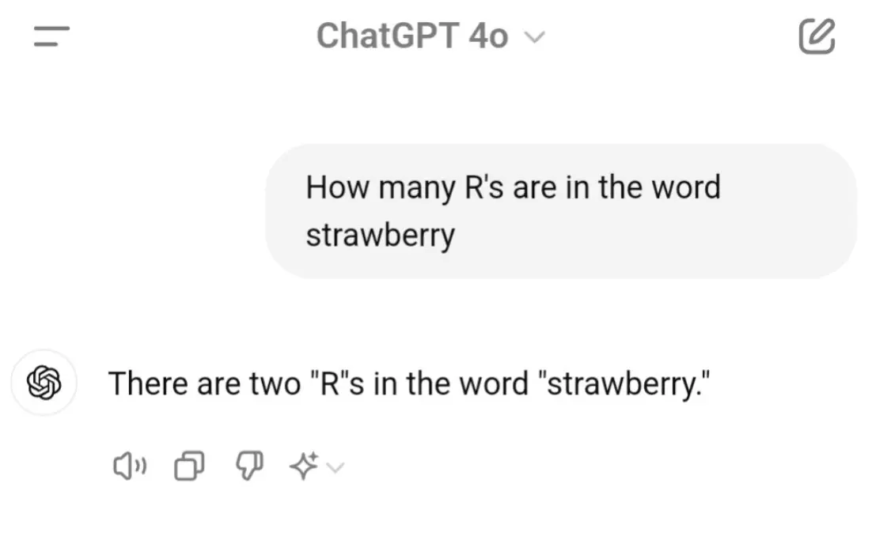
Project Strawberry
“There are 2 R’s in Strawberry.”
System 2 Thinking (Slow Thinking):
The model carefully checks each letter instead of guessing quickly.
Solution with Reasoning:
S-T-R (1) → A-W-B-E-R-R (2, 3) → Y → Total = 3 Rs in Strawberry.
o1 Preview (codenamed “Strawberry”) brought great excitement as the community realized Open AI was addressing a very real challenge using novel chain-of-thought training.
Now in GPT-5 we have ”Thinking mode” an extreme form of chain-of-thought reasoning. Today we have LRMs: Large Reasoning Models like Deepseek R1, Gemini Thinking and o3.
https://openai.com/index/learning-to-reason-with-llms/

Slide 62
AI Reasoning: Introducing the Power of Pause
Characteristic | Large Language Models | Large Reasoning Models
Training Data | Vas unstructured text corpora | Structured data and explicit reasoning frameworks.
Reasoning Depth | Limited to surface-level reasoning based on statistical patterns | Emphasizes causal relationships and systematic analysis
Adaptability | Generalizes broadly across diverse language tasks | Specializes narrowly in technical or logic heavy domains
Key Strength | Excels at translation, summarization and dialogue | Excels at math, coding, and multi-step decision making
Output Type | Produces probabilistic text outputs | Generates deterministic logical conclusions

Slide 63
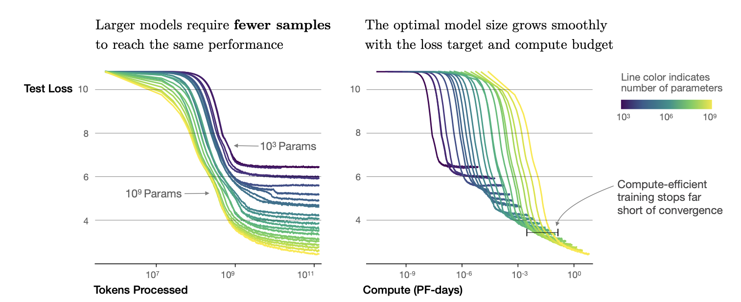
Scale Shift: From More Compute to More Thinking
Kaplan introduced our first pass at LLM scaling laws
The more processing power and more data lead to better performance, this is called the train-time compute scaling laws. However we were hitting fundamental limits… finite data and fine compute.
Using Chain-of-Thought, a new rule emerged….
https://arxiv.org/pdf/2001.08361

Slide 64
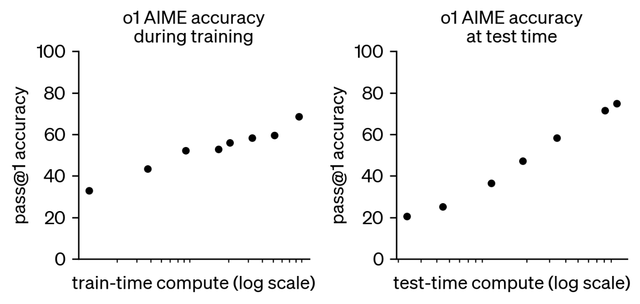
Test-Time Compute Scales Performance Better.
Open AI published performance of o1 accuracy with more train-time vs test time. Which graph is steeper?
https://openai.com/index/learning-to-reason-with-llms/

Slide 65
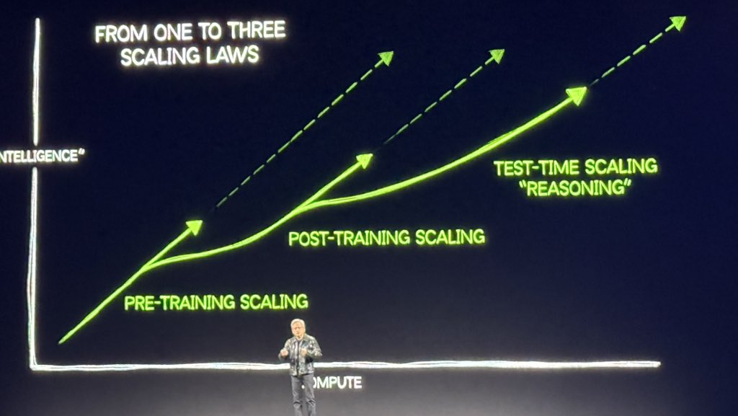
Test-Time Compute Scales Performance Better.
The new scaling laws means that training data is no longer the bottleneck, the longer LLM thinks, the better it becomes. For Agents, this is a massive leap forward. Reasoning, retrieving, refining, collectively means better performance, better outcomes.
https://openai.com/index/learning-to-reason-with-llms/

Slide 66
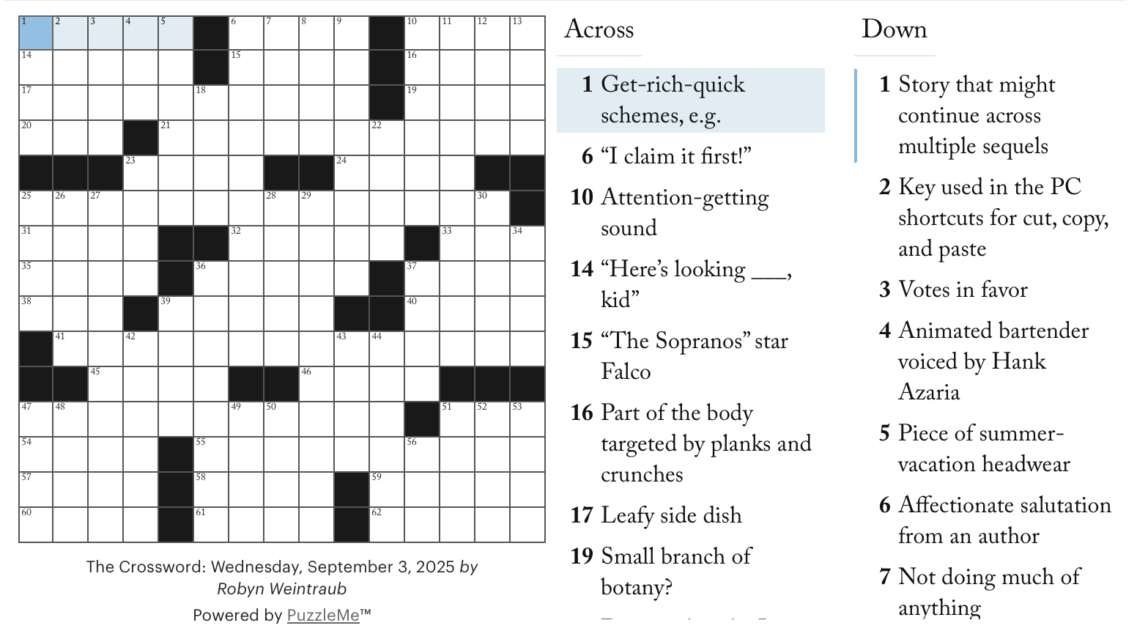
A Fun Experiment – Setting the Stage
What Puzzle requires System 1 and System 2 thinking?
On paper answering questions like “Name an R&B Singer” or “A guitarist with a top hat.” or system 1 thinking.
Yet we must address real constraints built into the puzzle like semantic correctness and spelling.

Slide 67
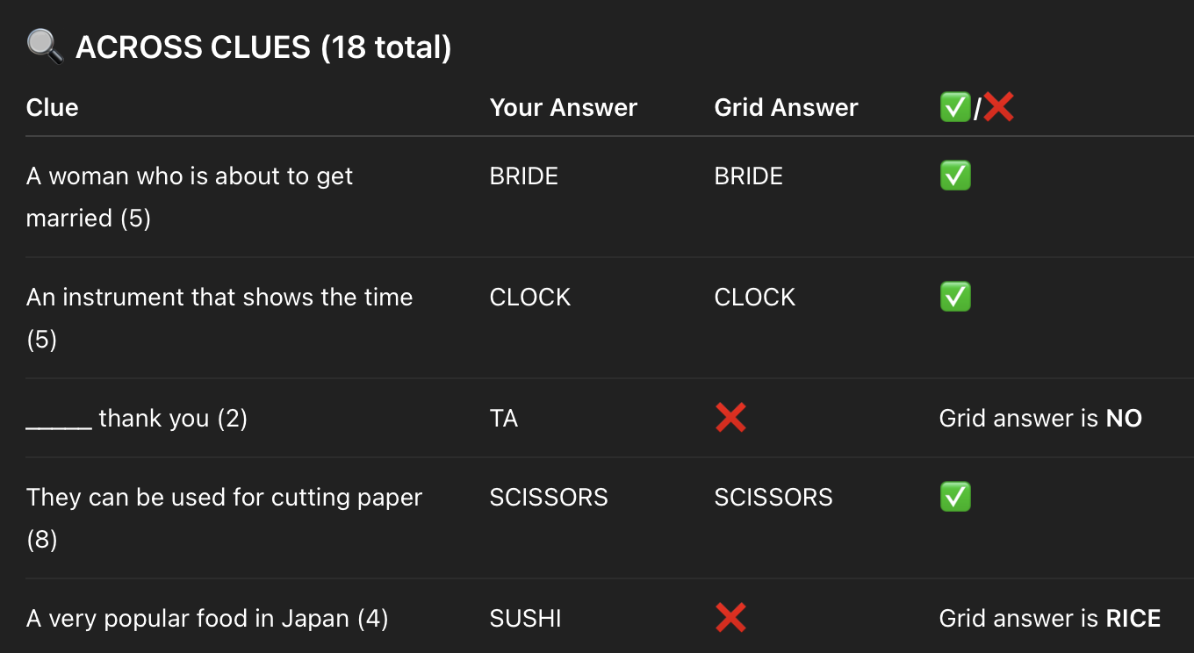
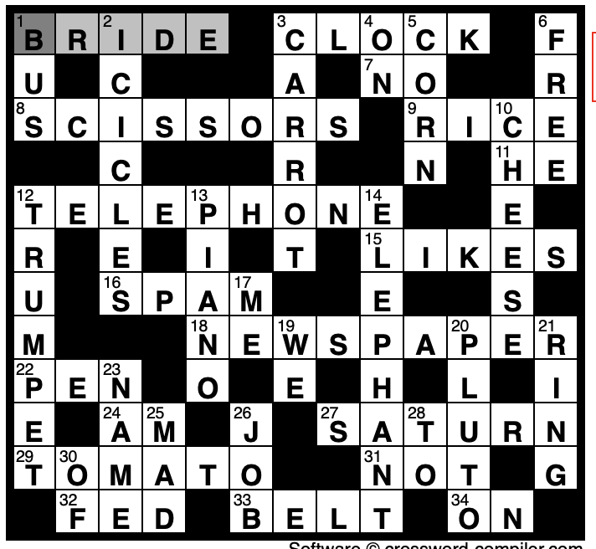
The Experiment with the LLM
The Flash or Instant Model is like a brilliant over confident student tackling an examine, diving headfirst.
The solution is filled out, impressive, but how many are correct…
Many up and down constraints are violated and have mismatching characters.

Slide 68
Understanding the Limitations
Context Fragmentation
Not a Formal Verifier
False Confidence
LLMs are not well calibrated. Due to their pretraining and amount of data, the probability masses are dramatically skewed (overconfident). LLMs tend to behave overconfident when faced with ambiguous or constraint heavy problems..
Humans hold multiple constraints in our mind both how semantic meaning should meet formal rules (up/down, across). LLMs attention mechanism may not retain the entire set of constraints.
Models are not formal logic checkers. They cannot solve with traditional grammeres and finite state machines. They will match data yet struggle to understand the simplist of rigid rules that require strict and precise adherence.
https://arxiv.org/pdf/2412.15296

Slide 69

Pattern Matching Challenges
Why did our experiment reveal fundamental limitations?
Let’s demystify what is going on:
  LLMs do not think in the way humans do. They perform Next Token Prediction (NTP).
  Even an extremely correct autocomplete cannot validate formal logic.
  Most LLMs perform some surface level reasoning just through “in-context learning”.
  The model matches with similar patterns and attempts to explain the prompt with a corresponding answer.
Why would the crossword be a challenge??
Any idea why there is a parrot here?
https://dl.acm.org/doi/10.1145/3442188.3445922

Slide 70

Demo

Slide 71
The Experiment with the LRM
Let’s Think this Through Step-By-Step
The LRM reveals its internal monalogue between it’s <reason> </reason> tags. It shows us an explainable and clear insight into how AI systems break down and solve problems.
The approach is vastly different from the LLM, for example, it starts with
  “Laying out the options, I am solving a crossword puzzle with across and down entiries where the count of the words must match along with their intersecting letters….”
Expert problem solvers often spend more time understanding the problem than attempting a solution, mirroring the phenomena between LLM and LRM.
Preparation builds a more complete problem space leading to a better estimation of the solution space.
https://arxiv.org/pdf/2404.01869

Slide 72
What does this mean for you?
As you build agentic software for business problems consider the strengths and weaknesses of LLM vs LRM.
  LLM: great for tasks involving brute compute such as generating documents
  LRM: best for mapping entire problem spaces, chains of dependencies, analyzing, and solutioning.
  Agentic: Combines both in a schema where Agents are primarily experts in their own craft either via task specific fine tuning (LLM), prompting (LLM), or via strategic reasoning steps (LRM).
Just as an LRM begins by mapping entire problem spaces before attempting solutions, organizations must lay out what an AI system should gather, analyze and act upon.

Slide 73
What does this mean for you?
AI systems need structure to understand their operational context.
For your business, this means investing in data infrastructure.
  The context we surround the LLM with is many times more important than the LLM.
  Develop clear protocols for gathering information for an agent and validating its decisions before they are acted upon.
A financial client implemented this by creating Decision Context Maps which were required to be verified prior to the final routing decision.
  These maps contained things like availability, account balances, credit limits, etc.
  They had a bug where if two people requested credit limits within seconds, they would have temporary access to twice the funds before it was eventually rejected.
  Having route “checkpoints” avoids cascading errors that often get amplified in agentic systems.

Slide 74
What does this mean for you?
Context Engineering
Most of the engineering goes into context engineering aka investing in everything around the LLM like data infrastructure. The context is more important than even the LLM!
Environment
AI systems need structure to understand their operational context.
Frequent Checkpoints
Decision Context Maps which were required to be verified prior to the final routing decision
Clear Protocols
DA finance client built Decision Context Maps which were required to be verified prior to the final routing decision
AI systems need structure to understand their operational context.
For your business, this means investing in data infrastructure.
  The context we surround the LLM with is many times more important than the LLM.
  Develop clear protocols for gathering information for an agent and validating its decisions before they are acted upon.
A financial client implemented this by creating Decision Context Maps which were required to be verified prior to the final routing decision.
  These maps contained things like availability, account balances, credit limits, etc.
  They had a bug where if two people requested credit limits within seconds, they would have temporary access to twice the funds before it was eventually rejected.
  Having route “checkpoints” avoids cascading errors that often get amplified in agentic systems.

Slide 75
Uncertainty with LRMs
Hypothesis testing
LRMs have the benefit of proposing, testing, adnd validating potential solutions. This doesn’t come without its tradoffs. More hypothesis means more solutions must be validated.
Dynamic Outputs
LRMs produce dynamic content and can find themselves changing correct answers to better align with new reasoning paths. The dynamic network of pathways can lead to cascading chaos.
Language
Opportunities
Reasoning
The reasoning paths are opportunites to succeed, but sometimes more importantly to fail. Build software that allows for improvement over time and for the agents to learn from failure.
E.g. design a cache of known failure approaches and supply them to the model at decision time.
Models

Slide 76

Metacognitive Awareness : An Interesting Phenomena in Reasoning Models
Metacognitive awareness, specifically meta-learning, will improve.
We see Metacognitive awareness in LRMs:
  “Progress is being made but we need to reconcile these discrepancies”.
Metacognition is a holy grain in AI development.
It provides an opportunity to improve calibration, explainability, and observability while recognizing uncertainty.
  Uncertainty might indicate a need for Human-in-the-Loop.
There are no strings on me.
https://arxiv.org/pdf/2207.14502

Slide 77
The Power of Many: Multi-Agent Systems in AI Reasoning
Single Reasoner
Scale test time compute and provide prompts that elicit thinking like, “What factors might make this recommendation unreliable?
Reasoning in an individual AI system is powerful.
A Debate
When researchers tested their debate framework, they found even with SLMs, the performance could exceed LLMs (on a 14x cost factor) Snell et. al.
Collaborative, even debate framworks with smaller models yield remarkable results in improving the reasoning capacity.
Multi-Agent
Smaller, more diverse models with more reasoning capabilities is a new paradign, effectively scaling down and scaling wide. While individually they might have limited knowledge, collectively they can surpass each other as a team; and operate at different ‘thinking’ speeds.
Engaging in debates with diverse peers, experts, yields the most powerful results. Architecting diversity introduced novel ideas and challenged the agents respective reasoning process.
https://arxiv.org/pdf/2305.14325, https://arxiv.org/pdf/2312.04854; https://arxiv.org/pdf/2408.03314v1;

Slide 78
Emergence of Collective Intelligence
Parallels To Humans
Diversity of Thought
When individual AI models were highly confident but wrong, the differing of perspectives through debate often resulted in a more calibrated confidence.
Building on the concepts of diverse input, AI platforms trained with different training paradigms (GPT vs Claude vs Cohere vs Gemini) introduce positive solution discovery.
Diverse Input
Covering Weakness
Combining the same model does not improve performance much, but adding diverse inputs and backgrounds greatly improves the performance.
Agents can cover each other weaknesses, for example due to tool provisioning or knowledge access limits, a model might excel at each others weaknesses
Iterative Problem Solving
Thought Leaders
AI Agents are thought leaders in themselves, and they can get stuck in certain patterns. When different modesl trained with different appraoaches tackle problems, it results in less thinking pitfalls
The effectiveness of multi-agent systems is about multiple engagements over time effectively a run time “teach student effect”
https://arxiv.org/pdf/2306.09299;

Slide 79
Pitfalls
02
04
03
Error Multiplication
01
Reasoning errors don’t simply accumulate, they multiple in a network effect and compound a noisy signal
Reasoning Checkpoints
Errors Spawn Invalid Reasoning & Action Chains
Isolation
Reasoning Checkpoints serve as circuit breakers that can intercede with human validation before propogation through system.
An agent might perform admirably in isolation yet their interconnected nature can create unexpected vulnerabilities
Small errors trigger a series of invalid, irrelevant reasoning and action chains. For example, a small reasoning error assessing network capacity can lead to load balancing spawning resource allocation and maintenance agents.
https://arxiv.org/pdf/2406.12374; https://ojs.aaai.org/index.php/AAAI/article/view/21498

Slide 80

A Successful Multi-Agent Orchestration
HITL
HITL
Set up explicit checkpoints for human in the loop and human scoring/validation.
Monitor for signs of error amplification in the system.
Checks
Request periodic system-wide consistency checks
Explain
Regularly ask agents to explain their dependencies on other inputs and gauge whether their output is faithful.

Slide 81
Looking to the Future: The Next Evolution in AI Reasoning
Three fundamental shifts have emerged that reshape our prior assumptions
Effective AI reasoning isn’t just about compute but rather performance follows a cadence of quick pattern recognition (system 1) and deeper, deliberative thought (system 2).
AI reasoning might not lie in building ever larger individual models but fostering productive interaction between diverse approaches and skillsets.
AI systems demand more human oversight and interaction. The best agentic systems do not minimize human involvement; they transform us into pseudo-operators.
Tomorrow
Today

Slide 82

Lunch
1 hour

Slide 83
Citizens AI Academy
Track / Content Name
August 2025

Slide 84
Section Title
Subtitle

Slide 85
Slide Content Template

Slide 86
Agenda Template
Agenda
xyz
xyz
xyz
xyz
Today’s objectives
xyz
xyz
xyz

Slide 87
Break
15 minutes

Slide 88
Demo

Slide 89

Lab

Slide 90

Hyper
sprint

Slide 91
Turbo
Breaks

